Slide 1

Tango eye: Growth in the metaverse
(Microsoft, 2019) Tech Pitch Deck

Slide 2

Meet our team
Uswat: Project Manager (PM) and DevOps
Samik: Business Analyst (BA) and Software Analyst
Shabbir: Quality Assurance (QA) and Software Developer
(Lau, 2023)The Metaverse, What is it?

Slide 3
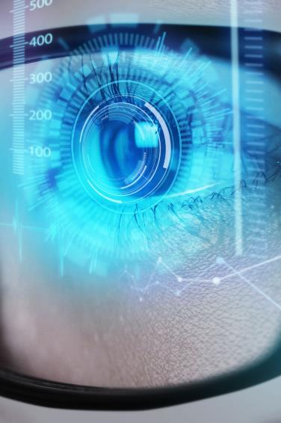
Overview of the Presentation
Aims and objectives
Metaverse
Tango eye
Problem statement
Functional and non-functional requirements
Pipeline of both models
Sentiment analysis
Live demo
evaluation
Test plan
growth strategy
PyCharm / GitHub
Crisp
agile
Quality plan
Risk assessment
Project schedule
individual contributions
Summary
references
(Microsoft, 2019) Tech Pitch Deck

Slide 4
Aims and objectives
Aims
Objectives
To deliver sentimental analysis for the metaverse’s dataset using a multi-modal approach.
To decide if Tango Eye would progress in the metaverse industry.
Selecting the company for the sentimental analysis.
Understanding the company’s objectives and success rate.
Creating a project plan.
To analyse, describe and clean the dataset collected from various sources like websites, pdfs, podcasts, and twitter data.
Selecting appropriate machine learning model for the company.
Evaluate and fine tune the machine learning model for better accuracy and performance.
Analysing our results to determine if Tango Eye should delve into metaverse.

Slide 5

Metaverse
(Mystakidis.S, 2022) The Metaverse combines physical and digital worlds, enabling multisensory interactions through VR and AR technologies.
It's a persistent, interconnected network of immersive environments where users can communicate, interact with digital objects, and move seamlessly between virtual spaces.
(Stefanic.D, 2023) Exploring How the Metaverse Will Affect Business in the U.S

Slide 6


Tango Eye
About:
Applications:
Tango Eye is a technology company headquartered in Silicon Valley, California, established in 2018. It was founded by a team of experts passionate about exploring the potential of augmented reality (AR) technology.
Tango Eye specializes in developing cutting-edge AR solutions for a wide range of industries.
Their AR technology allows users to overlay digital information onto the physical world, creating immersive and interactive experiences.
(Tango Eye, 2024) Tango Eye
(Microsoft, 2013) Tech Pitch Deck

Slide 7

Problem Statement
In response to Tango Eye's interest in exploring a new domain, the metaverse, as data analysts we are tasked with conducting a comprehensive data analysis on a multi-modal dataset. The insights gained would inform Tango Eye's decision-making process.
(Abimbole.A, 2023) The Metaverse and Its Implications for Digital Marketing

Slide 8

Functional and non-functional requirements
functional | Non-functional
Install libraries for web scraping, speech to text and machine learning task. | Access to the internet when working with google colab
Get a multi modal dataset from various sources like websites, podcasts and social media. | Getting a Deep gram API
Cleaning the dataset | Installing necessary libraries in the environment when working with PyCharm
Labelling the dataset using a pretrained model | Running the speech-to-text code in PyCharm or Python shell
Data understanding using exploratory data analysis
Building a machine learning model using various models and feature engineering methods
Model tuning by changing the train: test ratio and various hyperparameters | ​
Evaluating models using various metrics like Precision, Recall, Accuracy
(Microsoft, 2019) Tech Pitch Deck

Slide 9
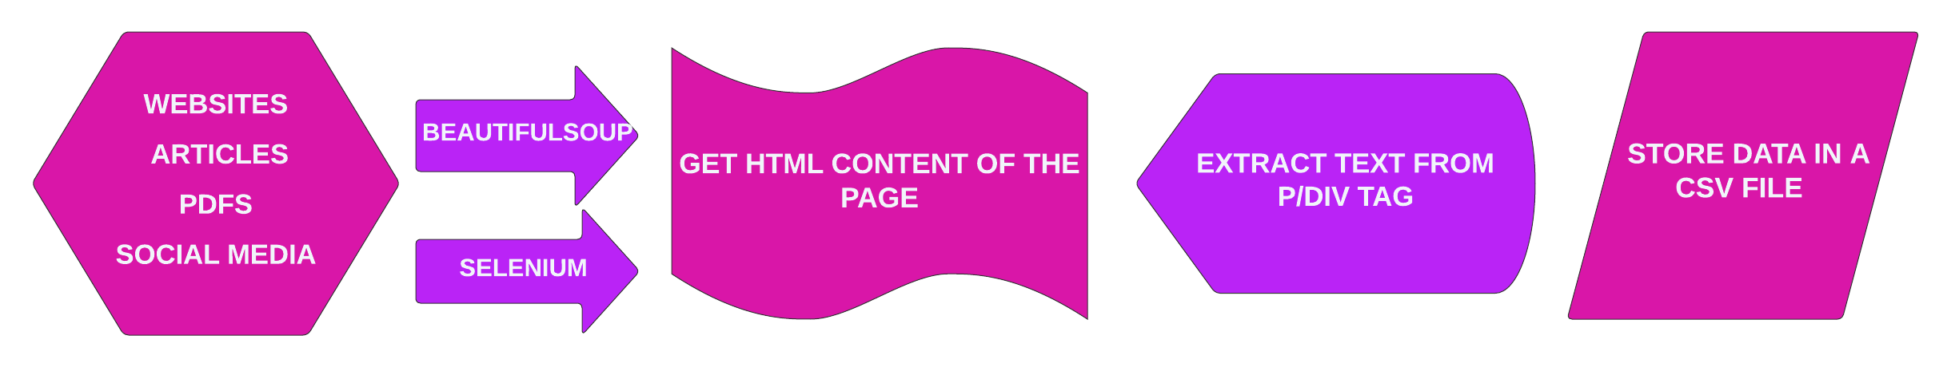
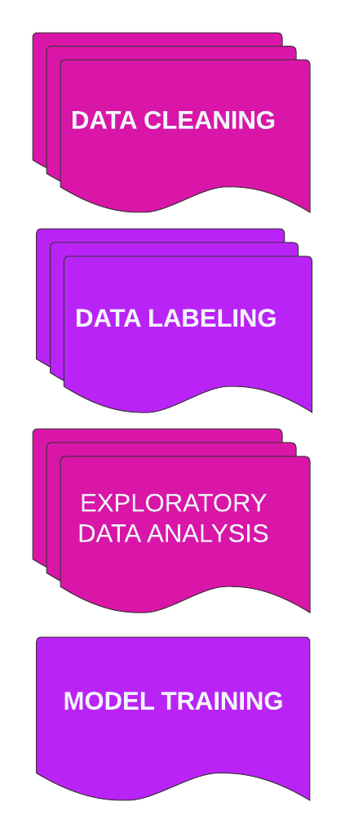
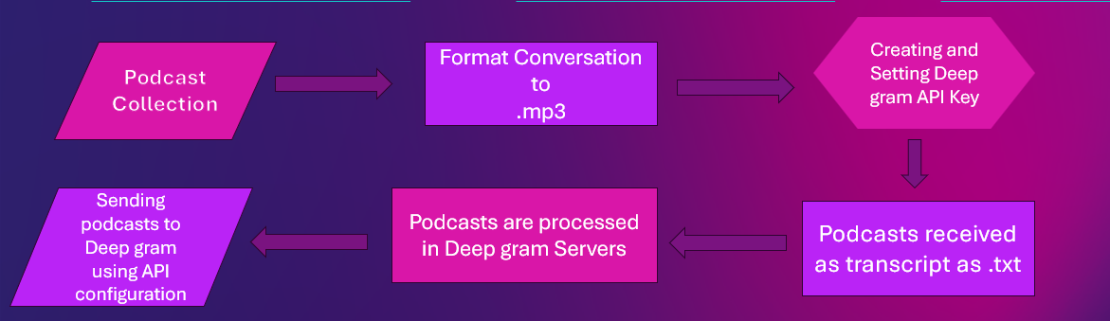
Pipeline of Web scraping / Speech-to-text

Slide 10
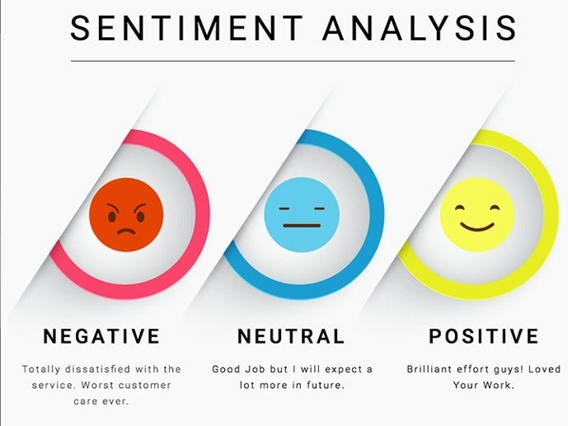
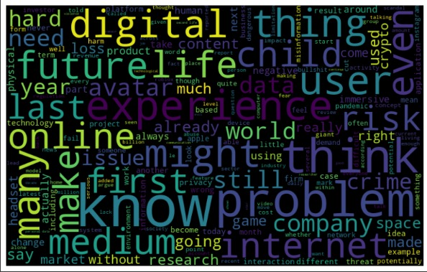


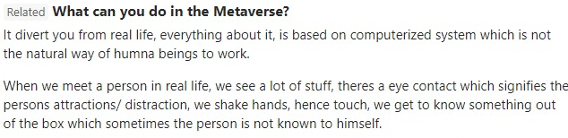
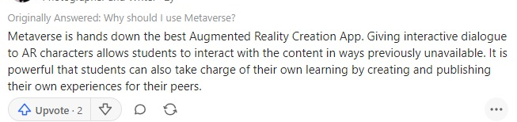
Sentiment analysis
(Dixit, 2020) Sentiment Analysis: Building from the Ground Up
(Chandra.A , 2022) Why should you care about the metaverse
(Kaushik. P, 2022) Why should I use Metaverse?

Slide 11
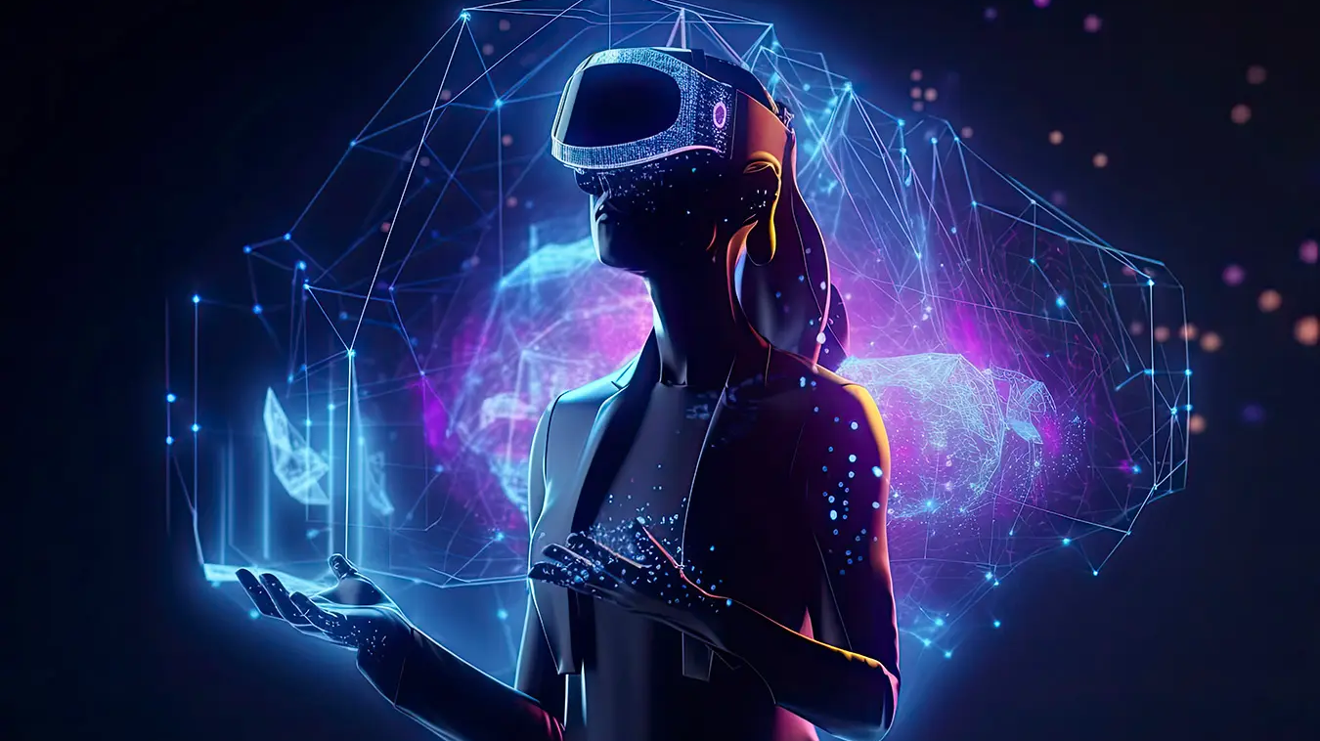
Live demo
https://www.youtube.com/watch?v=uW-e1_3w9u8
(Wallis. J, 2023) Unravelling the Metaverse: The Tech Behind Series

Slide 12
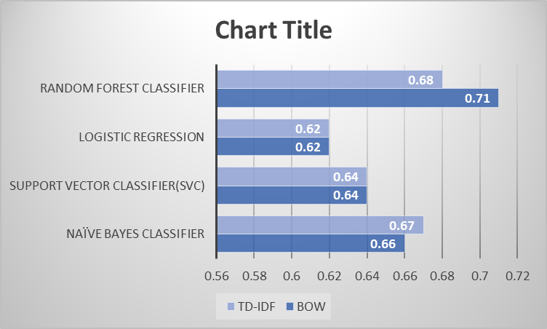
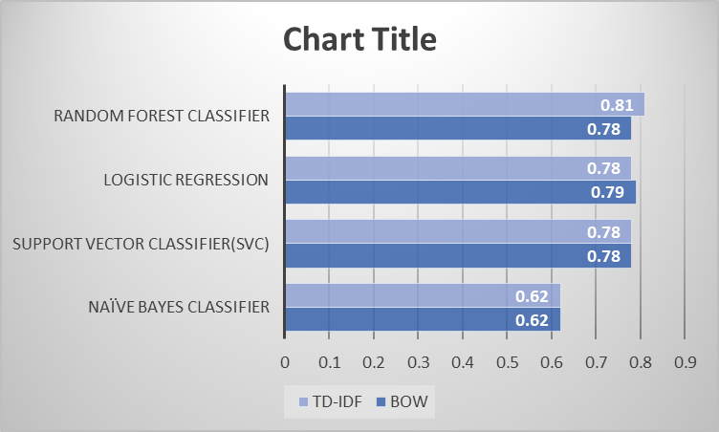
evaluation
UNBALANCED DATASET
BALANCED DATASET

Slide 13
Test plan
Serial no. | Test case description | Expected results | Actual results | Pass/fail | comments
1 | Scrape websites using Beautiful Soup and Selenium and get data from them in form of paragraphs | Scraped data stored in a csv file | Scraped data stored in a csv file | Pass | Beautiful Soup did not work for dynamic websites so Selenium was used in place of it. Authorization issues which prevented scraping.
2 | Scrape comments from Quora and Reddit | Scraped comments stored in a csv file | Comments in a csv file | Fail | Authorization issues. We had to result to “copy and paste”
2 | ​ Converting Podcast into transcript using Google recognizer | Receive full transcript | Receive limited segments of transcript | Fail | The outcome was limited and alternative is considered.
4 | ​ ​Using alternative for Google recognizer | To find workable alternative to Google recognizer | The Diagram was used and provided detailed transcript. | Pass | The transcript generated by Deep gram was quite accurate and consistent.

Slide 14
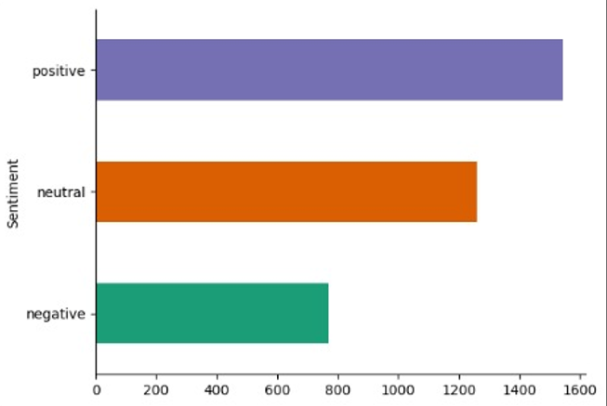
Growth strategy
How Tango Eye will scale in the future​
Retail costs
Virtual stores
Marketing & innovation
Brand visibility
(Tango Eye, 2024) Tango Eye

Slide 15
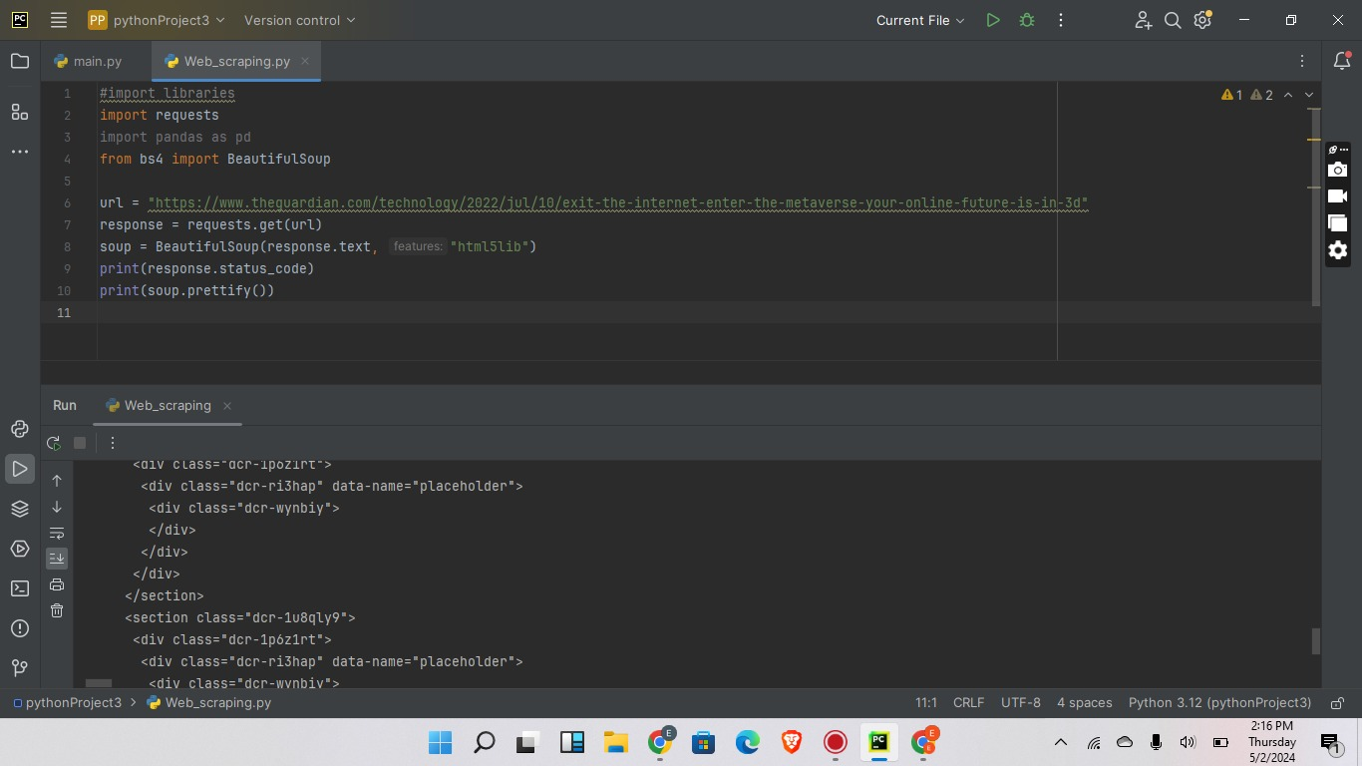
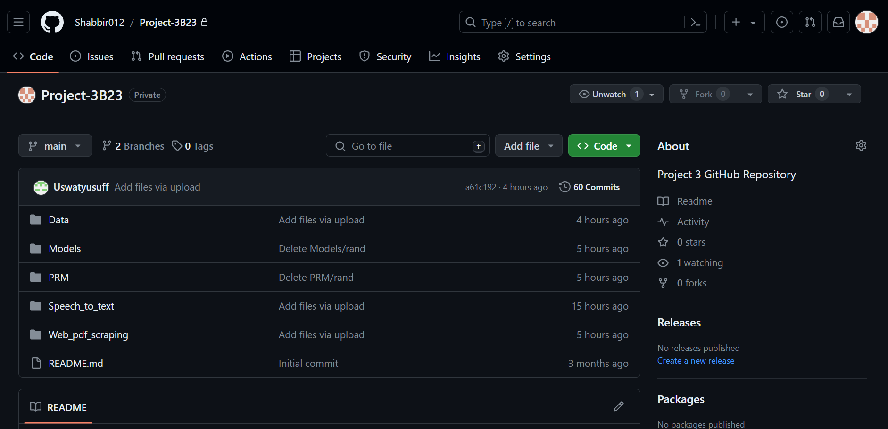
https://github.com/Shabbir012/Project-3B23
PyCharm
GitHub

Slide 16
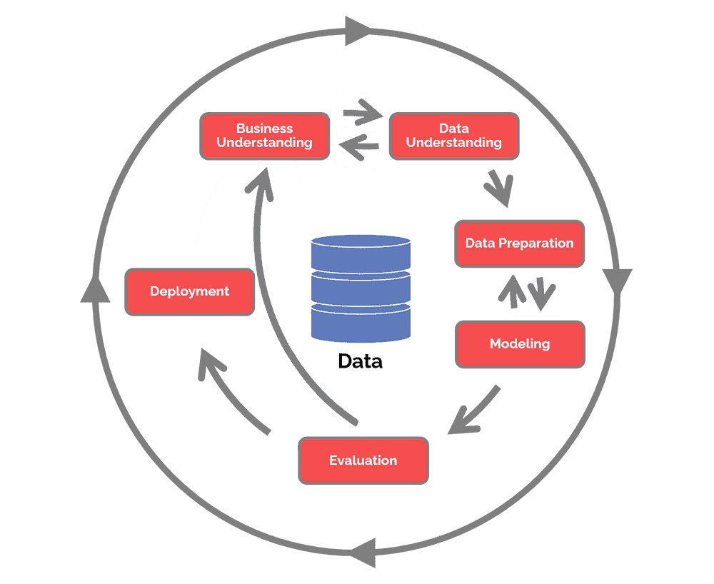
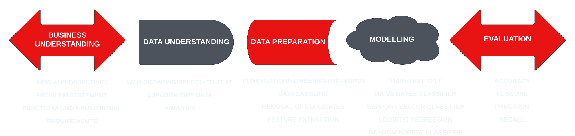
Crisp DM
What is crisp dm?
(Hotz,2024) The Cross Industry Standard Process for Data Mining is a process model that serves as the base for a data science process.
(Hotz,2024), What Is CRISP DM?

Slide 17
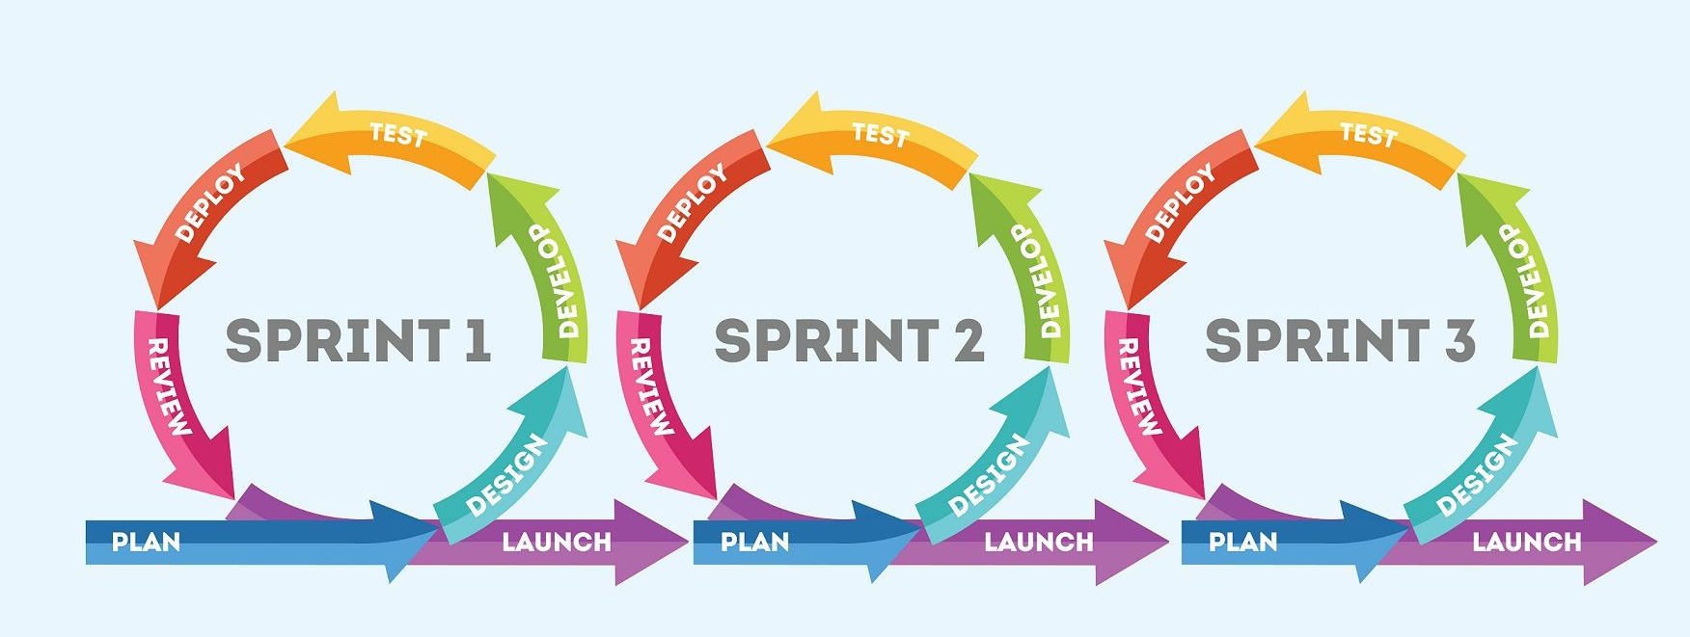
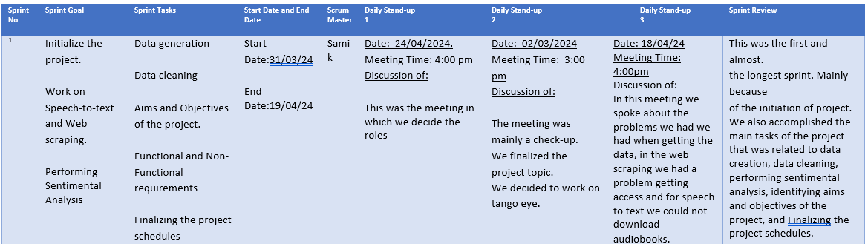
Agile
(Alina.S, 2020), Is Agile always the best solution?

Slide 18
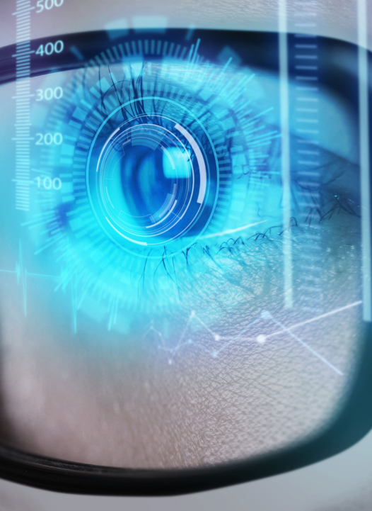
Quality plan
Quality goals | description
Reliability | ​ Both models should be able to perform their functions without any failure. ​
Maintainability | ​ The Speech-to-text and Web-Scraping models should be maintained by detecting errors and correcting them. ​
Accuracy | Both models should also be accurate, by reviewing it and ensuring that it meets all requirements for it to be accurate.
Correctness | ​ ​Both models should meet all its requirements.
Usability | For the model to be able to detect sentiment within sentences
(Microsoft, 2019) Tech Pitch Deck

Slide 19
Risk Assessment
Risk description | Type | probability | Effect | Resolution
Lack of Data​ | Project​ | High​ | This can lead to incompletion of tasks which could affect the completion of our project. | Finding other sources of data
Inadequate time allocation | Project, People | High​ | This can lead to incompletion of the project at hand due to under estimation of time. It would also increase the pressure on team. | Allocating time to different tasks based on their level of difficulty. Also, setting more time for the difficult tasks.
Underestimating time to create the models | People | High | This may cause group members to become disorganised and waste time attempting to solve a single code. | Set priorities for their work and make sure they receive responses before going on to the next code.
Merging the Data | Technical Risk | Moderate | As a result, data may become dispersed and our work may not be visualised. | Make sure the data is properly combined and that there is a story to tell.
Size of the Data | Technical Risk | Low | This may result in technological problems and raise concerns for the organisation because the software is large and will require sorting. | Make sure the software is the correct size, that it is saved to the correct location on files, and that a backup copy is kept.
Inaccurate solution provided | Project | Moderate​ | This can reduce the efficiency of the solution proffered to the problem. | Understanding each problem, doing external research when necessary and collaborating to find the most effective solution.
Tools | People | Moderate | This may result in the software's correct code being ineffective, providing an insufficient resolution. | Ensuring that codes are reviewed by other team members and figuring out how to make the code function
Poor team Relation | Project, People | Low​ | This can reduce the morale of the team members and reduce their efficiency in carrying out respective tasks thereby affecting the project at hand. It could also lead to conflicts. | Building good relationship with each other by listening and respecting each individual’s opinion and reaching a common ground as a group.

Slide 20
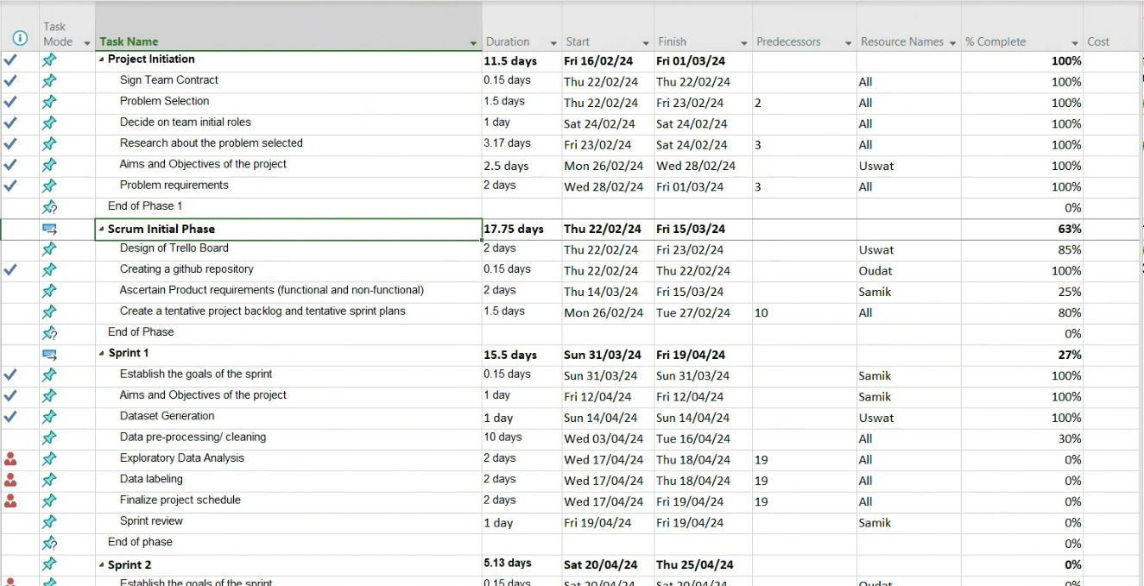
Project plan

Slide 21
Individual contributions
Task | Completed by
Submission of Project | Uswat​
Dataset Generation | Uswat
Test Plan | Uswat
Sprint Review | Uswat
Trello Board | Uswat
Functional and Non-Functional Requirements | Samik
Aims and Objectives | Samik
Sprint Review | Samik
GitHub | Samik
Creation of Presentation Skeleton | Shabbir
Risk Assessment Table | Shabbir
Quality Plan | Shabbir
Sprint Review | Shabbir

Slide 22
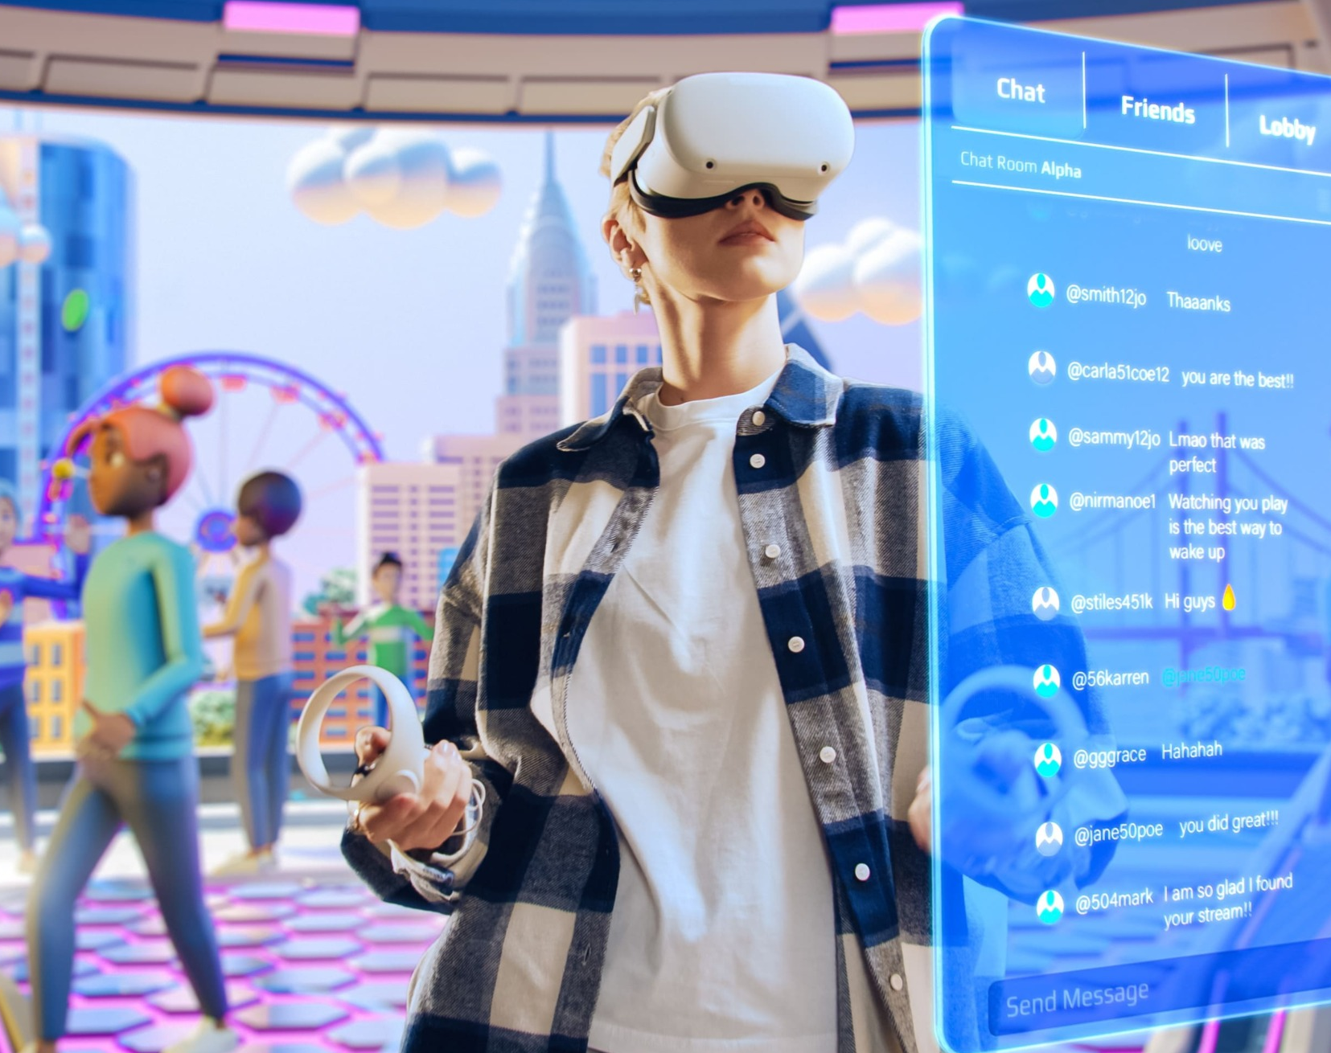
Summary
As a team of junior engineers at FALL we had to employ a multi-modal approach to conduct data driven decision marking.
We have tackled the problems by creating an agile project management plan and implemented this into our work by creating sprint plans. We have created diagrams which helped in the design and implementation phase of each system. We have tested, validated and evaluated these systems using an appropriate metric.
We have assessed our project by creating a risk assessment table, quality control plan, and test plan which has made our project more effective.
Overall: We have performed sentimental analysis on the dataset that we created under the context of Metaverse and Tango eye. To present a theory on how Metaverse can be beneficial for the Tango Eye.
(Marr. B, 2023) How Will The Metaverse Really Affect Business?

Slide 23
references
Hotz, N (2024) What is Crisp DM? Available at: https://www.datascience-pm.com/crisp-dm-2/ Accessed on 26 April 2024
Alina.S (2020) Is Agile always the best solution Available at: https://soldevelo.com/blog/is-agile-always-the-best-solution-for-software-development-projects/ Accessed on 26 April 2024
Tango Eye (2024) Tango Eye Home Available at: https://tangoeye.ai/ Accessed on 27 April 2024
Mystakidis.S (2022) Metaverse. Encyclopedia Available at: https://www.mdpi.com/2673-8392/2/1/31 Accessed on 27 April 2024
Microsoft (2019) Tech Pitch Deck Available at: https://create.microsoft.com/en-us/template/tech-pitch-deck-a78aa185-0dd3-40b1-afe5-a7e4ced62287 Accessed on 27 April 2024
Lau.W (2023) The Metaverse, What is it? Available at: https://www.searchenginejournal.com/metaverse/484803/ Accessed on 28 April 2024
Wallis.J (2023) Unraveling the Metaverse: The Tech Behind Series Available at: https://intuji.com/the-metaverse-the-tech-behind-series/ Accessed on 28 April 2024
Marr.B (2023) How Will The Metaverse Really Affect Business? Available at: https://bernardmarr.com/how-will-the-metaverse-really-affect-business/ Accessed on 28 April 2024
Abimbola.A (2023) The Metaverse and Its Implications for Digital Marketing Available at: https://mauconline.net/the-metaverse-and-its-implications-for-digital-marketing/ Accessed on 29 April 2024
Stefanic.D (2023) Exploring How the Metaverse Will Affect Business in the U.S Available at: https://hyperspace.mv/exploring-how-the-metaverse-will-affect-business-in-the-u-s/ / Accessed on 30 April 2024
Dixit.P (2020) Sentiment Analysis: Building from the Ground Up Available at: https://medium.com/analytics-vidhya/sentiment-analysis-building-from-the-ground-up-e12e9195fac4 Accessed on 30 April 2024
SlideMembers (N.D) Vision of the Metaverse professional presentation Available at: https://in.pinterest.com/pin/vision-of-the-metaverse_169_ms-powerpoint--1146447648873015145/ Accessed on 1 May 2024
Chandra.A (2022) Why Should you care about the Metaverse? Available at: https://www.quora.com/Do-you-agree-that-we-need-a-Metaverse/answer/Akshit-Chandra-5?ch=10&oid=298963937&share=1f410295&srid=3ngHem&target_type=answer Accessed on 1 May 2024
Kaushik.P (2022) Why should I use Metaverse? Available at: https://www.quora.com/Do-you-agree-that-we-need-a-Metaverse/answer/Prince-Kaushik-27?ch=10&oid=306307523&share=3f2e91d1&srid=3ngHem&target_type=answer Accessed on 1 May 2024

Slide 24
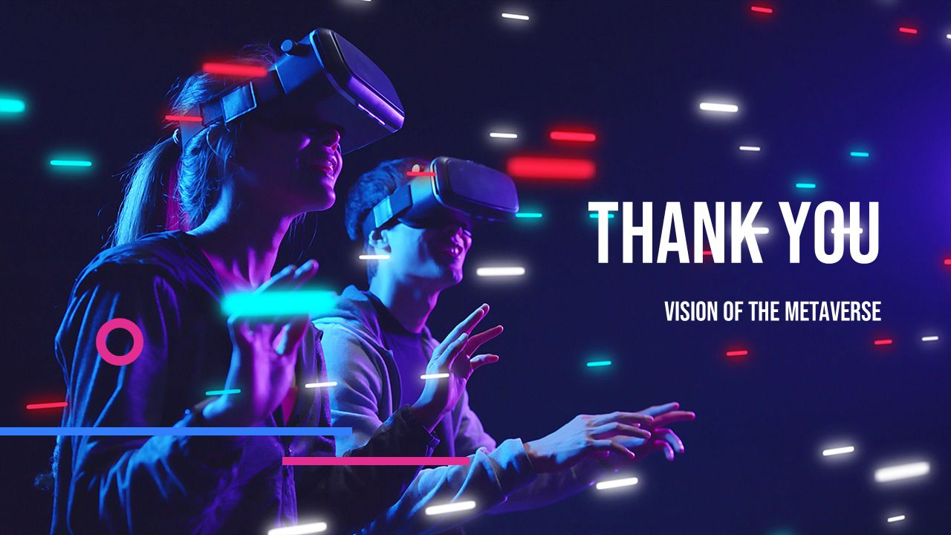
(SlideMembers, N.D) Vision of the Metaverse professional presentation

